Slide 1
Topic 3 Footprinting
ST251Y Ethical Hacking and Defences

Slide 2
Topic 3 : Footprinting
Footprinting or Information Gathering
Use Web tools for footprinting
Use DNS and DNS zone transfers
Viewing information in HTTP
Identify the types of social engineering

Slide 3
Stages of Penetration Testing
Stage 1 : Information Gathering (or also known as Footprinting)
Stage 2 : Network Discovery
Stage 3 : Vulnerability Assessment
Stage 4 : Exploiting
Stage 5 : Post-Exploit

Slide 4
What is Footprinting?
Discover information about
The organization
Its network
Usually such information is available on the Internet
Information gathered may be used to determine how to conduct security test (for hackers, the information can be used to determine how to attack!)
Size of the network
Operating systems used

Slide 5
Information Gathering
Numerous resources to find information legally
Identify methods others can use to find information about your organization
Companies should try to limit the amount of information that is available publicly

Slide 6
Footprinting
What are some of the information that you like to find out?
Domains
The target may own more than one domain
Visible Systems
How many systems can be accessed publicly?
Software Services available
What are the main public services provided? Test are generally for standard service ports like 21, 22, 25, 80, 443
IP Addresses discovered
Knowing their range of IP addresses may tell us how big their networks are
Gateway Routers
this may tells you who their Internet Service Provider is.

Slide 7
Footprinting
What are some of the information that you like to find out?
Primary Operating Systems being used
Windows or Linux or some other OS?
Firewalls
Which kind of Firewalls are they using?
Intrusion Detection Systems / Intrusion Prevention Systems
Is there one? Will it track us?
Web Technologies
Is their web site using Python, JavaScript, ActiveX, etc?.
Are they hosting their web servers in-house or using cloud technologies

Slide 8
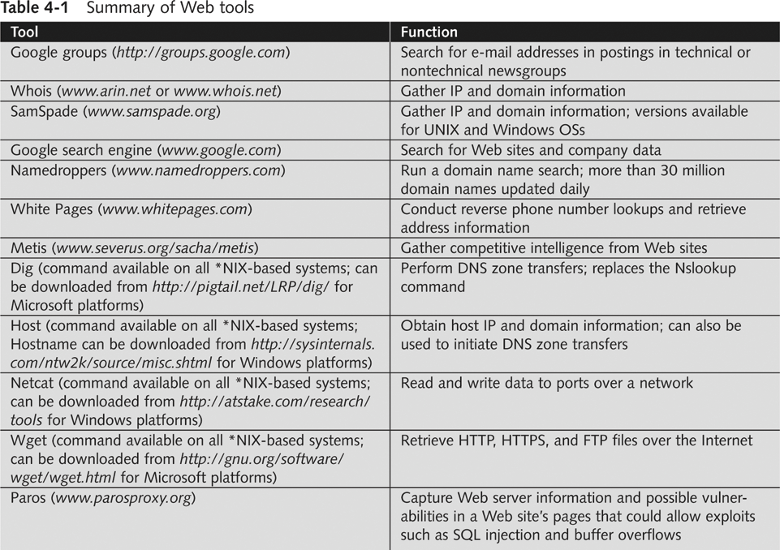

Slide 9
Advanced Web Searches
Google allows different forms of advanced searches
Examples
To find a certain word or file on a website
site:www.example.com keyword
Eg site:www.sp.edu.sg exams
To find certain filestypes containing keywords
filetype:type site:www.example.com keyword

Slide 10
Advanced Web Searches
Examples (continued)
To find webpages with a certain string in its URL
inurl:string site:www.example.com
Eg inurl:login site:www.sp.edu.sg
(Look for pages in www.sp.edu.sg that contains the string “login”)
To find webpages with a certain string anywhere in the text
intext:string site:www.example.com
http://www.googleguide.com/advanced_operators_reference.html

Slide 11
Whois
Domain names are registered with NICs (Network Information Centre)
Regional Internet Registries handle IP allocation
American Registry for Internet Numbers (ARIN)
Asia-Pacific Network Information Centre (APNIC)
Whois databases allow queries on who owns a domain, contact information, IP range, etc.

Slide 12
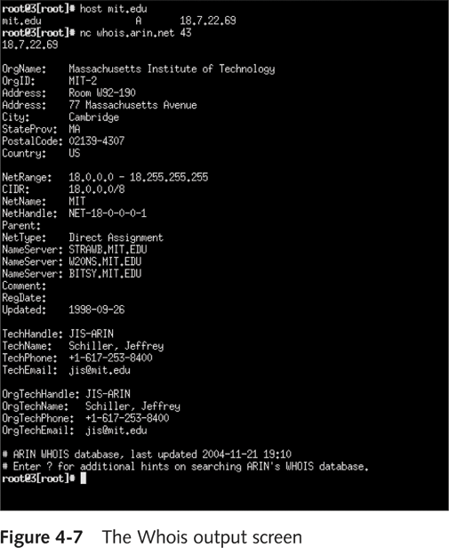

Slide 13
Using E-mail Addresses
E-mail addresses help you retrieve information too
Find e-mail address format
Guess other employees’ e-mail accounts
Bounce an email using a non-existent account
Read the mail header
Get information about servers
Tool to find corporate employee information
Groups.google.com

Slide 14
Analyzing a Company’s Web Site
Web pages are an easy source of information, eg. preferred web technologies, type of OS, webserver, etc
Simplest tool is browser
View Source – sometimes useful information can be found in comments
<html>
<head>
<title>ABC E-Commerce Website</title>
<!-- Developed by DEF Web Developers Company -->

Slide 15
Finding information about connected devices
Shodan
www.shodan.io
Search engine for online devices
CNN article on Shodan
http://money.cnn.com/2013/04/08/technology/security/shodan/index.html

Slide 16
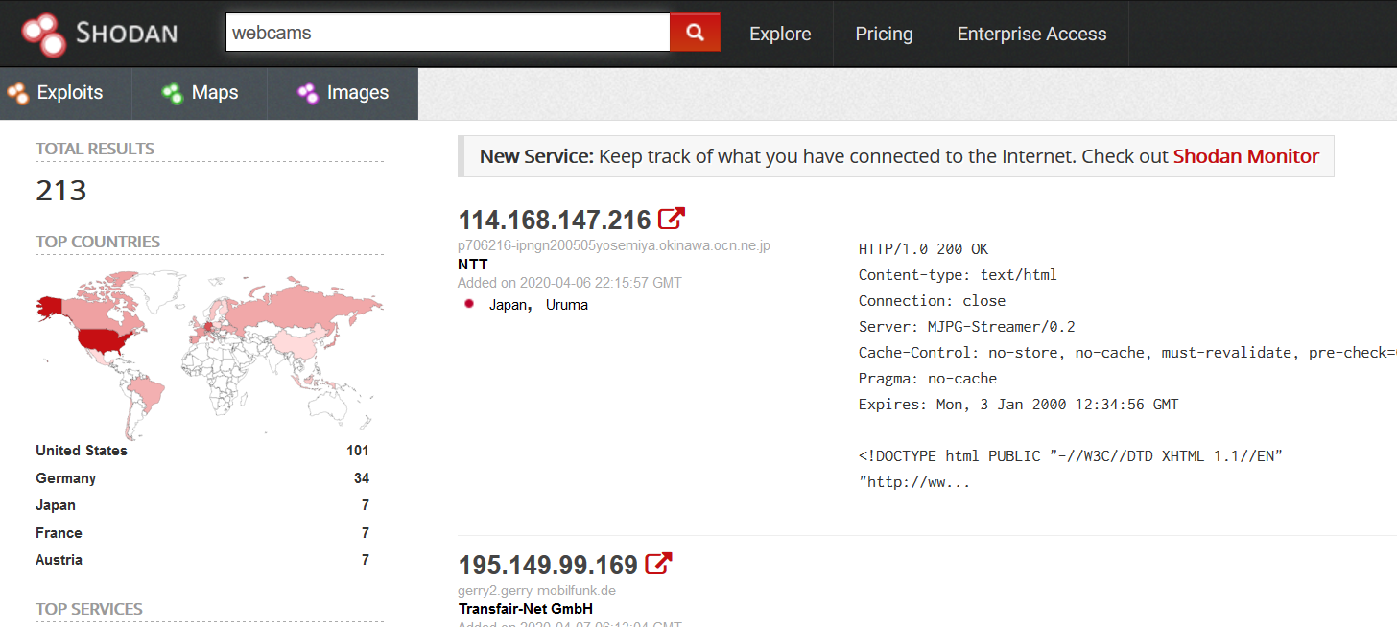
Shodan sample listing

Slide 17
Exercise
Practical 3 Exercise 1 – gather information from the Internet

Slide 18
Using Domain Name Service (DNS)
DNS
Resolves host names to IP addresses
People prefer using URLs to IP addresses
Can be vulnerable to attacks
DNS Query tools
nslookup
Dig
Host
Whois

Slide 19
Using Domain Name Service (DNS) Zone Transfers (continued)
Determining company’s primary DNS server
Look for the Start of Authority (SOA) record
Shows zones or IP addresses
Zone Transfer
Enables you to see all hosts on a network
Gives you organization’s network diagram

Slide 20
Other DNS Whois Tools
www.whois.net
Greenwich
Wikto
SmartWhois
ActiveWhois
SpiderFoot
www.dnsstuff.com
www.mxtoolbox.com

Slide 21
Traceroute
Why traceroute?
To trace the route of packets from the source to the destination
May be used to find out the gateways/routers used by the target
Uses ICMP (Windows) or UDP (Linux)
TTL values is used to trace the route
However, routers may block the packets from a traceroute
Perform traceroute from different countries
Use online traceroute tool

Slide 22
Exercise
Practical 3 Exercise 2 – Using dig, nslookup, host and zone transfers
Practical 3 Exercise 3 – find network information about a company
Practical 3 Exercise 4 – find information on intermediate nodes

Slide 23
Analyzing a Company’s Web Site
Tools like intercepting proxies can be used, eg:
Paros
Webscarab
BurpSuite
Developer Tools feature on Web Browsers (press F12)

Slide 24
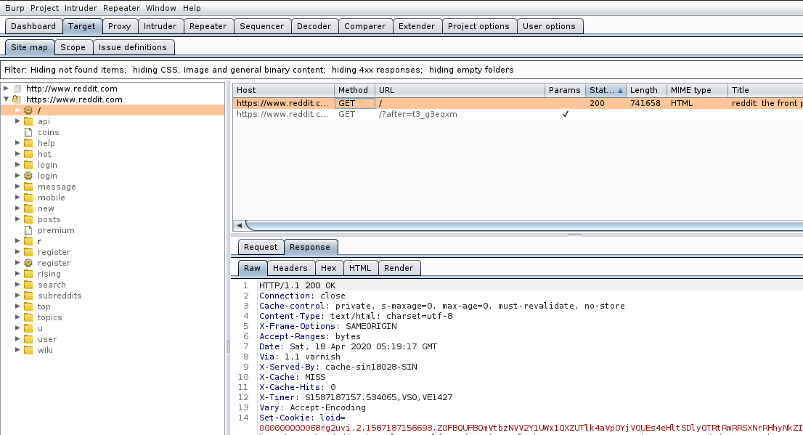
BurpSuite : to passively scan a website

Slide 25
Copying whole websites
Tools are available to copy the whole website
The pages of the website can then be inspected and analysed offline
HTTrack Website Copier (www.httrack.com)

Slide 26
Using HTTP Basics
HTTP operates on port 80
Use HTTP language to pull information from a Web server
Basic understanding of HTTP is beneficial for security testers
Return codes
May reveal information about system

Slide 27
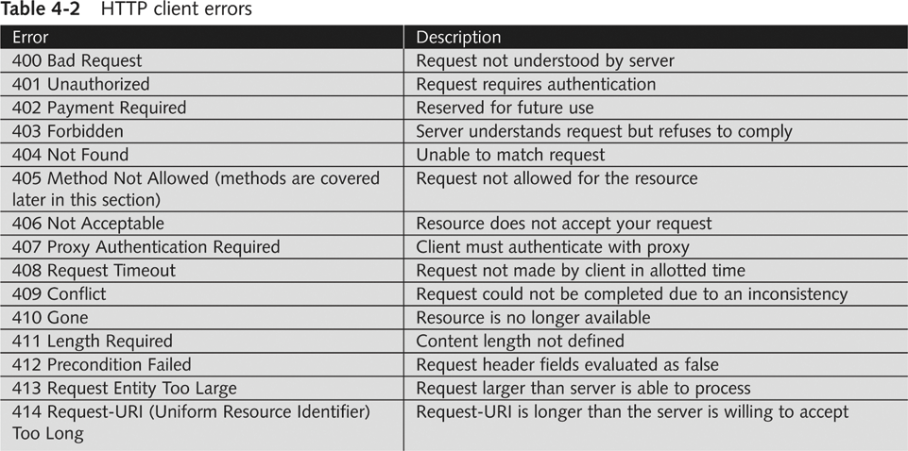
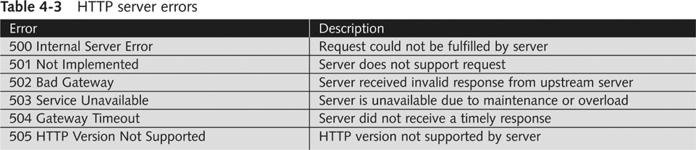

Slide 28
Using HTTP Basics (continued)
HTTP methods
GET / HTTP/1.1. is the most basic method
May be able to determine information about the Web Server from the server’s HTTP response packet

Slide 29
HTTP headers
Every HTTP packet (request or response) contains a set of header fields
HTTP headers may contain information on
Web Browser of the client making the request
Operating System of the client
Web Server returning the response
Cookies

Slide 30
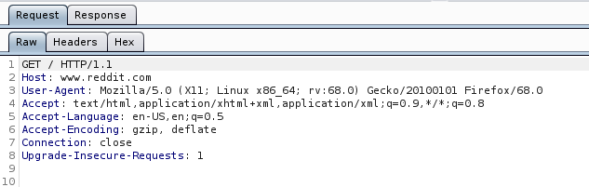
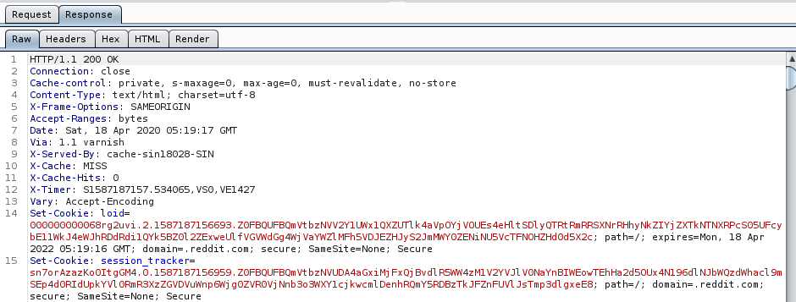
Viewing HTTP Request Headers in BurpSuite
Viewing HTTP Response Headers in BurpSuite

Slide 31
Exercise
Practical 3 Exercise 5 Burpsuite
Practical 3 Exercise 6 HTTP headers

Slide 32
Social Engineering
Using knowledge of human nature to get information from other people
Example : Attacker poses as IT helpdesk and calls unsuspecting staff to get information about the company network
Can be the biggest security threat to networks
Most difficult to protect against

Slide 33
Techniques of Social Engineers
Urgency
“I need the information now or the project will fail!”
Help with problems
“I can solve your Internet connection speed problem if you can tell me …”
Everyone else is doing it
“John has already given me his account information so …”
Kindness and charm
Authority
“The Director needs this information now!”

Slide 34
Shoulder Surf
Look at what the user is entering on the keyboard, especially usernames and passwords
Shoulder surfers may stand behind people at the ATMs to see the PINs being entered
Use of camera phones to take photos and videos increase this threat

Slide 35
Dumpster Diving
Going through the trash!
Lots of valuable information can be found
Discarded Windows XP manuals – the company has upgraded their Windows OS?
Company organizational charts
Printouts of emails
Discarded hard disks, USB drives – deleted data may still be retrieved from them
Documents should be shredded
Use disk-cleaning software to wipe out all data before discarding disks

Slide 36
Piggybacking
Trailing authorised staff closely to enter restricted areas
May carry a fake staff card or badge and rely on the kindness of people to hold the door open for them
May carry big boxes and rely on people to open secured doors for them

Slide 37
Phishing
Phishing emails are urgent emails that seem to be from legitimate companies asking you to click on a link to provide or update your details
The link usually leads to the attacker’s website
Spear phishing
Sent to specific people in an organization

Slide 38
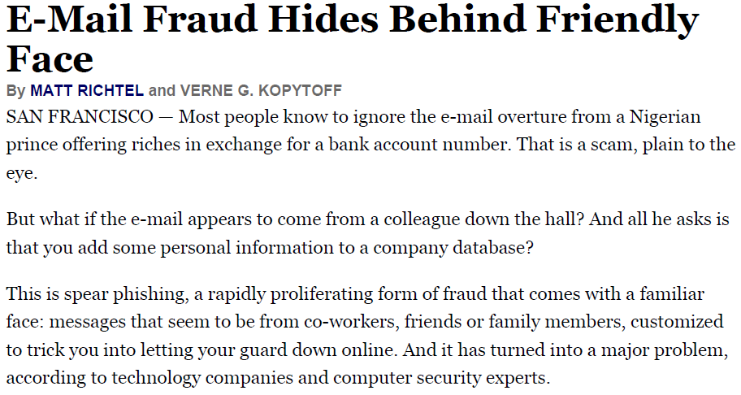

Slide 39
Dear Paypal customer,
We recently noticed one or more attempts to log in your Paypal online account from a foreign IP address and we have reasons to believe that your account was hijacked by a third party without your authorization.
If you recently accessed your account while traveling, the unusual log in attempts may have initiated by you.
However if you are the rightful holder of the account, click on the link below and submit, as we try to verify your account:
https://www.paypal.com0m/cgi-bin/webscr?cmd=_login-submit
The log in attempt was made from:
IP address: 157.6.177.243
ISP host: abelibrary.com
If you choose to ignore our request, you leave us no choice but to temporally suspend your account.
We ask that you allow at least 48hrs for the case to be investigated and we strongly recommend not making any changes to your account in that time.
Thanks for your patience as we work together to protect your account.
Regards,

Slide 40
Phishing not limited to emails
Phishing also occurs in mobile messages
Example of Phishing SMS
POSB
We are blocking your account. Please confirm device immediately, follow this link posb-dbs-shield.com/6512345678

Slide 41
View Email Headers
Learn how to find e-mail headers
After you open e-mail headers, copy and paste them into a text document
So that you can read them with a text editor
Headers contain valuable information about the sender
Unique identifying numbers, IP address of sending server, and sending time

Slide 42
View Email Headers
Useful website to learn about Email headers
https://www.arclab.com/en/kb/email/how-to-read-and-analyze-the-email-header-fields-spf-dkim.html
From UOB Cards Marketing Fri May 15 20:28:30 2015
X-Apparently-To: mary@yahoo.com; Fri, 15 May 2015 20:28:36 +0000
Return-Path: <bounced@edm.uob.com.sg>
X-Originating-IP: [203.126.11.71]
Authentication-Results: mta1328.mail.bf1.yahoo.com from=eDM.uob.com.sg; domainkeys=neutral (no sig); from=eDM.uob.com.sg; dkim=neutral (no sig)
Received: from 127.0.0.1 (EHLO ntvwlpsg08) (203.126.11.71)
by mta1328.mail.bf1.yahoo.com with SMTP; Fri, 15 May 2015 20:28:36 +0000
X-TM-IMSS-Message-ID:<291178ac0040454b@uob.com.sg>
Date: Sat, 16 May 2015 04:28:30 +0800
Return-Path: bounced@edm.uob.com.sg
To: mary@yahoo.com
From: UOB Cards Marketing <marketing@eDM.uob.com.sg>
Reply-To: helpme@uobgroup.com
Subject: <ADV>Enjoy 10% off at Sakae Sushi with UOB Cards (ref: 5818)
Message-ID: <59a58ef1a2fa8ee8af87c4aab1dc06a1@localhost.localdomain>
X-Priority: 3
X-Mailer: PHPMailer (phpmailer.sourceforge.net) [version 2.0.0 rc3]
MIME-Version: 1.0
Content-Type: multipart/alternative;
boundary="b1_59a58ef1a2fa8ee8af87c4aab1dc06a1"
Content-Length: 20467

Slide 43
View Email Headers
Information in Email Headers to look out for
Return path
Recipient’s e-mail address
Type of sending e-mail service
IP address of sending server
Name of the e-mail server
Unique message number
Date and time e-mail was sent
Attachment files information
Use Whois or other databases to find out true source of email

Slide 44
Exercise
View Email Headers
Practical 3 Exercise 7
What information is my web browser providing to the Internet?
Practical 3 Exercise 8
Do the Footprinting (Information Gathering) Quiz on Brightspace

Slide 45
Summary
Stage 1 of Pen-Testing : Footprinting or Information Gathering
Use Web tools for footprinting
Use DNS for footprinting
Viewing information in HTTP request and response headers
Identify the types of social engineering
Do the Footprinting (Information Gathering) Quiz on BlackBoard

